Slide 1


Project Overview Advanced Control of Robotic Surface Treatment ARM-TEC-18-01-F-03 UTRC RPI
Cara Mazzarini, PM
Arnie Kravitz, Chief Technology Officer
Dr. Chuck Brandt, Deputy Director Technology Development

Slide 2
Kick-off Meeting Agenda & Goals
Agenda
Project Overview (Project Team)
CDIP Goals (Project Team)
Reporting and Meeting Expectations (ARM PM)
Cost Share Guidance (ARM CFO & PM)
Publication Guidance (ARM PM)
Evaluation Guidance (ARM PM)
Final Demonstration (ARM/Project Team)
Deliverables
Task/Milestones schedule
Invoice/Cost Share burn rates
Re-occurring meeting times scheduled

Slide 3
Project Timeline
Project Start
Monthly Rpts
May 1
Dec 15
Project Kickoff
Monthly Rpts
Project Finish
Jul 23
Jan 15
Apr 30
2019
May
Jul
Sep
Nov
2020
Mar
May
2020
Jun 15
Today
Aug 15
Oct 15
Dec 15
Feb 15
Apr 15
Jun 29
Monthly Report
Monthly Report
Mid-Program Review
Monthly Report
Monthly Report
Monthly Report
Final (Tech) Report
May 15
Jul 15
Sep 15
Nov 15
Mar 15
Monthly Report
Monthly Report (25%)
Monthly Report
Monthly Report
Monthly Report
Jan 15
Monthly Report (75%)

Slide 4
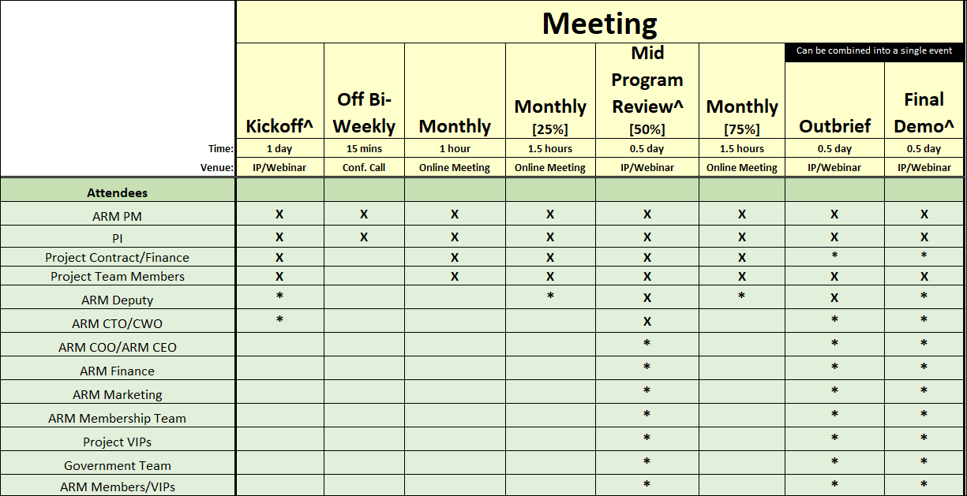
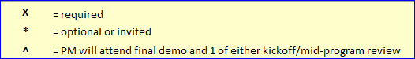
Required Meetings and Attendees

Slide 5
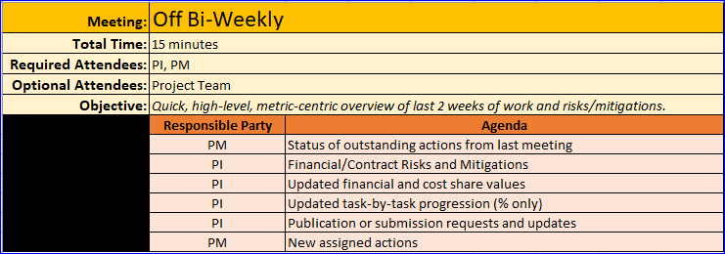
Meeting Agendas

Slide 6
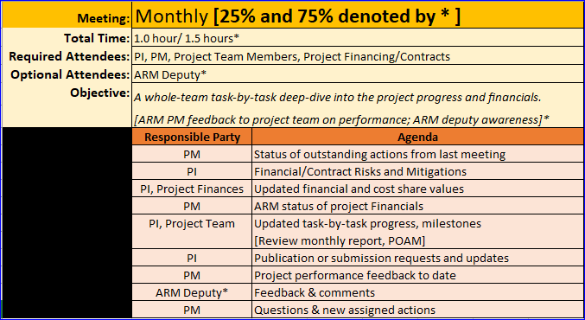
Meeting Agendas (cont.)

Slide 7
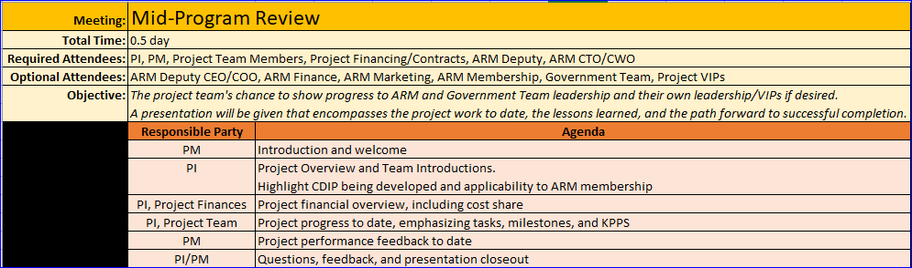
Meeting Agendas (cont.)

Slide 8
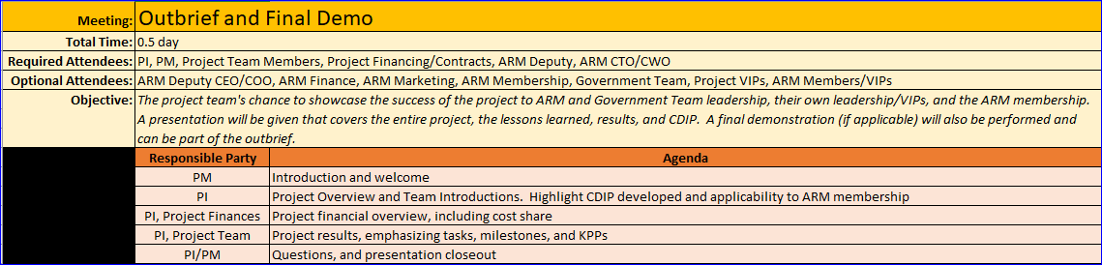
Meeting Agendas (cont.)
THIS IS YOUR SHOW.
It is the project team’s victory lap

Slide 9
Reporting Documents Required
Bi-Week
No deliverable documents
Monthly
Annual Financial (SF425) [1/15 - covers previous calendar year]
Final
Final Report
Final Financial Report (SF425)
Invention Disclosures etc.
Final demo & presentation
Monthly Report
POAM Updates
Quad Chart
15 minute phone call, responsibilities covered in “Bi-Weekly Agenda”
Cost Share
*Mid-Program Review Presentation*
Due 15th of each month. Covers previous month.

Slide 10
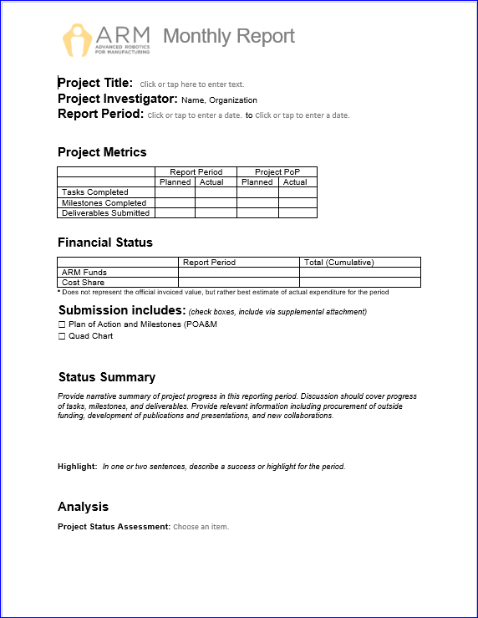
Monthly Reporting
Monthly Report
Due to PM@arminstitute.org
on the 15th of each month
Also send to ARM Project Manager
Highlight project progress & issues

Slide 11
Monthly Reporting
Plan of Action & Milestones
Due to PM@arminstitute.org
on the 15th of each month
Also send to ARM Project Manager
Update completion percentages, dates
Will be used to discuss progress during monthly call

Slide 12
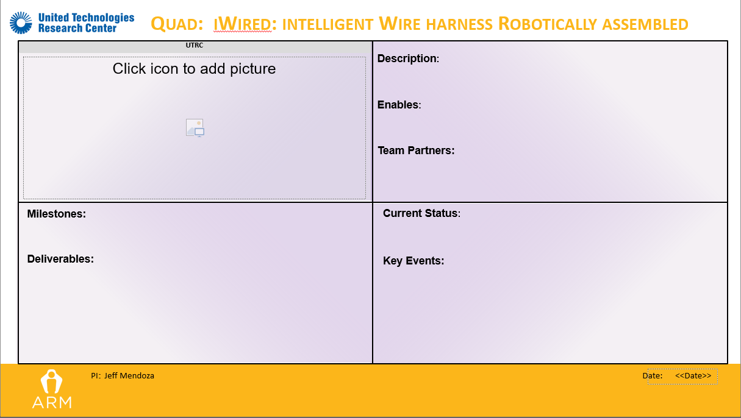
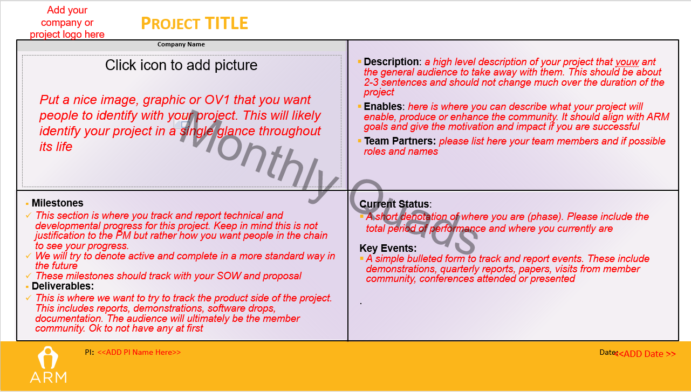
Monthly Reporting (cont.)
Quad Chart
Due to PM@arminstitute.org on the 15th of each month
Also send to ARM Project Manager
Represents outward facing view of projects
Way to show off accomplishments – think of ARM membership as the primary audience
Instructions
Monthly Reporting (cont.)
Quad

Slide 13
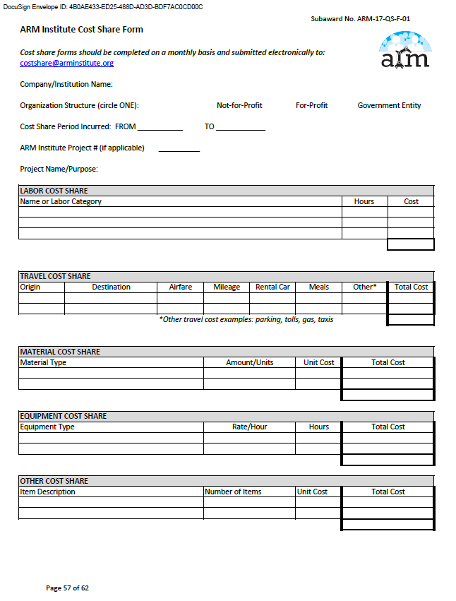
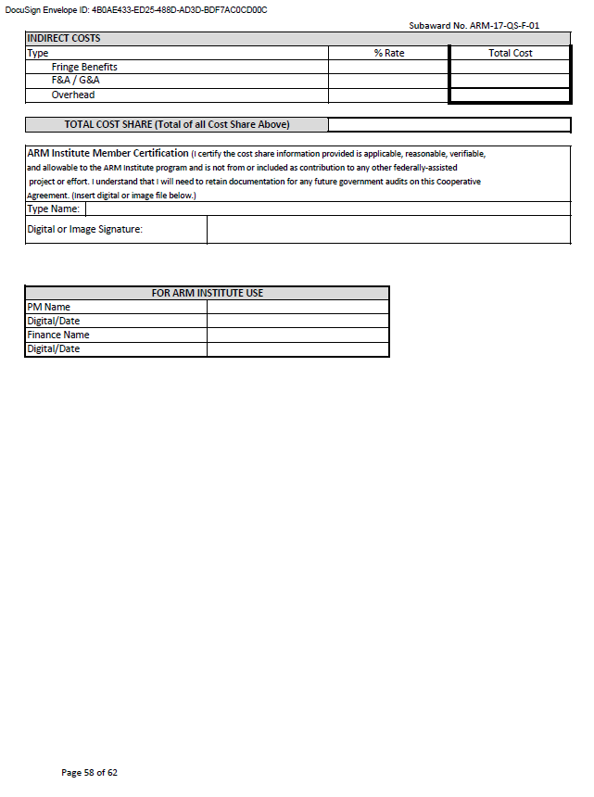
Cost Share Form
Monthly Reporting (cont.)
Due to costshare@arminstitute.org 15th of each month
Covers CS from previous month
Eg: April 15 submittal covers CS from 3/1-3/31
Can use single or multi-organization form
PI is ultimately responsible for project cost share submissions
Visit ARM Community website for official CS guidance policy
DO NOT SEND A COPY TO THE PM

Slide 14
Financial Reporting
SF425 http://www.arl.army.mil/www/pages/shared/documents/425_ff_report.pdf
Send all forms to contracts@arminstitute.org & pm@arminstitute.org
Financial Annual Report
No later than Jan 15th for previous calendar year.
Financial Final Report
No later than 60 days from Agreement End Date.

Slide 15
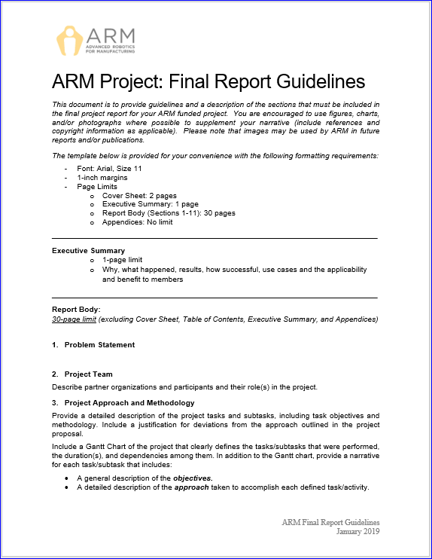
Final Reporting
Due to PM@arminstitute.org no later than 60 days from Agreement End Date.
Also send to ARM Project Manager
Detailed Final report
Template provided
A complete closeout packet will be sent as the project nears completion (75%)

Slide 16
Final Presentation & Demo
A Final Presentation and Demonstration of the Project is required
These will often be combined into 1 session, but are 2 distinct deliverables
The presentation portion covers the project in-depth from idea to finish and allows for audience questions
This will likely be accomplished through webinar
The demonstration is the function of the end result or CDIP. This includes in-person and/or through video
These serve to tell the story of the project and to highlight its success
Audience is ARM, ARM Membership, Government team, and any applicable project VIPs
Must be within PoP in order to invoice or claim as project cost share
Guidance will be delivered as the project nears its end

Slide 17
Program Feedback
Delivered formally at 25%, 50%, 75% meetings and at project completion
Evaluated on various factors ARM PMs track
On-time submission of required documents
Forms and documents filled-out correctly
Overall project schedule progress
Completion of tasks
Invoice/CS budget
Results feed into end of project ARM review, results of which are considered in future project calls and funding opportunities

Slide 18
Media & Publication Policy
Specified in Subaward and ARM membership agreement
General guidance: any publication, or media release involving ARM or Gov’t must be approved by ARM.
Submit ASAP, but NLT 1 month before desired publishing date
Send request with pertinent info to ARM PM
CC the following
suzy.teele@arminstitute.org
chuck.brandt@arminstitute.org [TECH] or stephen.catt@arminstitute.org [EWD]

Slide 19
Questions and Take-Aways
Who are the best contacts for the project?
Team meetings already in place?
Preferred meeting software?
Fileshare or other software being used?
How will the project handle Cost Share reporting?
Questions for ARM Staff?

